Slide 1

Teams Direct Routing
Opportunity or Threat??
Matt Hurst
mhurst@rbbn.com

Slide 2
Direct Routing – Opportunity or Threat?
Microsoft have changed their Cloud architecture for Voice, and are embracing carriers to deliver PSTN Services to Teams
‘Direct Routing’ PSTN capability makes things much simpler – opens up opportunity to deliver PSTN services directly to the cloud.
Enterprises can maintain their existing carrier contracts, and just change the delivery model – moving to the Teams cloud at their pace.
Carriers can support existing customers on this journey, and pick up new customers with Teams Cloud offerings.

Slide 3

Enterprise Voice Strategy for today’s Cloud
Microsoft 365
TEAM WORK
Microsoft Teams
PBX
Phone System
Microsoft
Calling Plans
Connect own trunk using Direct Routing
PSTN DIAL TONE
Communication Credits

Slide 4
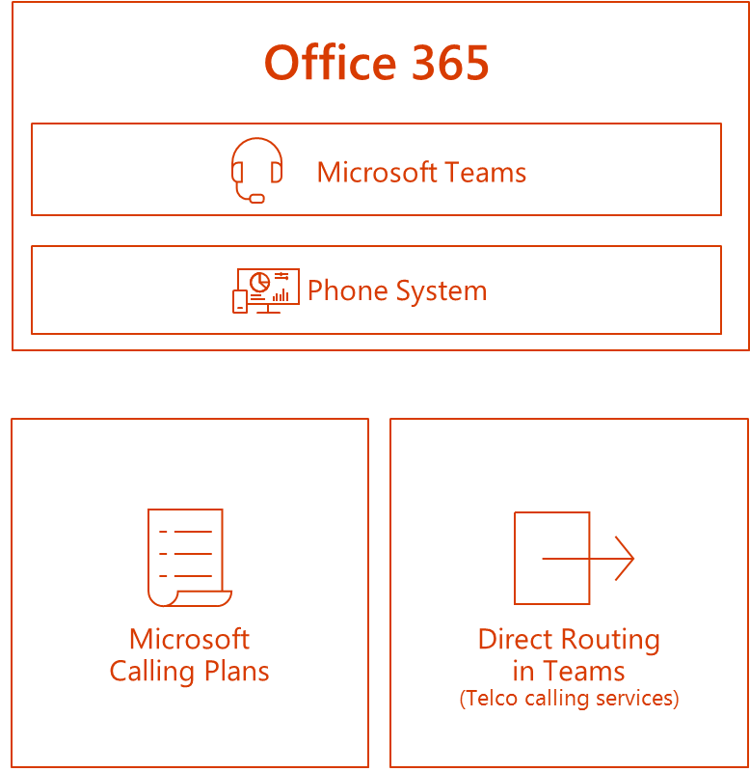


Why Would Enterprises Use Direct Routing with an SBC?
Phone system calling plan costs may not meet enterprise budget
Microsoft calling plan may not be available in enterprise location/country
Customer is in the middle of existing contract with Carrier
Notes:
Brad

Slide 5
Carrier Direct Routing
Delivering the True Cloud Experience

Slide 6
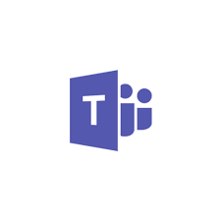

Carrier Direct Routing
Carrier Direct Routing connects MS Teams tenants to Service Provider Hosted Core SBC
  SBC hosted by Service Provider or Partner
  SBC connected to multiple Office 365 tenants
  SBC must be certified by Microsoft – Ribbon SBC is certified
Hosted Core SBC with multi-tenant architecture to support multiple customers
  SBC 5400, SBC 7000, SBC SWe
Enterprise customers benefit from the full Cloud experience, and the added flexibility / choice of SIP carrier services
Carriers can deliver calling plans, plus additional hosted services such as call centre applications
Teams
Client A
Hosted
Ribbon SBC
Teams
Client B
Teams
Client C
PSTN

Slide 7
Understanding Direct Routing: Enterprise vs Carrier
Enterprise
  Supports only 1 customer
  SBC connected to a single Office 365 tenant
  Allow smooth migration to Teams
    From OPCH, CCE, Skype on Prem,…
Tenant Client
Teams
SfBO
Service
Provider
CCE
Carrier mode
  SBC connected to multiple Office 365 tenants
  1 Certificate and 1 IP per SBC
IP-PBX/3d Party
Teams
Client A
Service Provider 1
Teams
Client A
Partner Datacenter
Ribbon SBC
Service Provider
Ribbon SBC
Teams
Client B
Teams
Client B
Teams
Client C
Service Provider 2
Teams
Client C

Slide 8
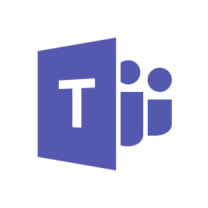
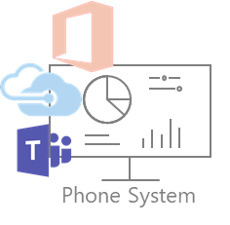


Carrier Support for Large Enterprise Deployments
Additional Benefits of Carrier Deployed SBC with Direct Routing
CONNECTIVITY
SECURITY
Remote
Carrier
POLICY
MEDIA SERVICES
SCALABILITY & PERFORMANCE
G.729
G.711
Avaya
IP-ACD
& IVR
M
M
Cisco CM
Cisco CM
Cincinnati Contact Center
Boston Data Center / Headquarters
Tampa Regional Office
Notes:
POLICY
Resource allocation
Traffic policing
Rate limiting
Call admission control
TOS/DSCP bit setting
MEDIA SERVICES
DTMF relay and interworking
Codec transcoding
Tones and announcements
Data and fax interworking
Support for voice and video calls
efore and after picture. Key business case point is as follows:
$450 to $600 per month for a PRI times 2 to 4 PRI per branch office times 100s of branch offices.

Slide 9
Carrier Direct Routing – a Compelling Opportunity
Microsoft embracing carrier services to deliver faster turn-up into Teams
Extends reach and depth of services and options available to customers
There is a ‘registration’ program, vs a full interop for each carrier
  Must be using a qualified SBC device such as that from Ribbon
  Faster time to market for both Carrier and Microsoft
Many Enterprises almost fully SIP enabled, thus reducing the need for CPE
  Declining legacy estate on-premise
  Looking for Opex, Cloud based solution
Notes:
Don’t Microsoft compete with Carriers?
Not any more with Teams – as mentioned above, Microsoft have changed their approach to SIP trunk connectivity into the Teams cloud.
Yes, previously with the Skype for Business (SfB) cloud model, there was a lot of focus on the PSTN calling plans that Microsoft offered directly, and this was perceived as a threat from many carriers.
Microsoft at this stage were encouraging Enterprises to migrate their lines and numbers from their existing carrier to them – a one stop shop, and one bill for everything. Microsoft were trying to own it all and become a global carrier.
There were only 3 or 4 carriers that were interconnected out the back of the Microsoft cloud – Tata, Colt, Bandwidth.com for example.
In addition to their own Calling Plans that Microsoft offer for SfB in the cloud, they recognized the fact that many customers needed a solution to connect their own SIP trunk (or ISDN trunk via a Gateway).

Slide 10

Questions?

