Slide 1
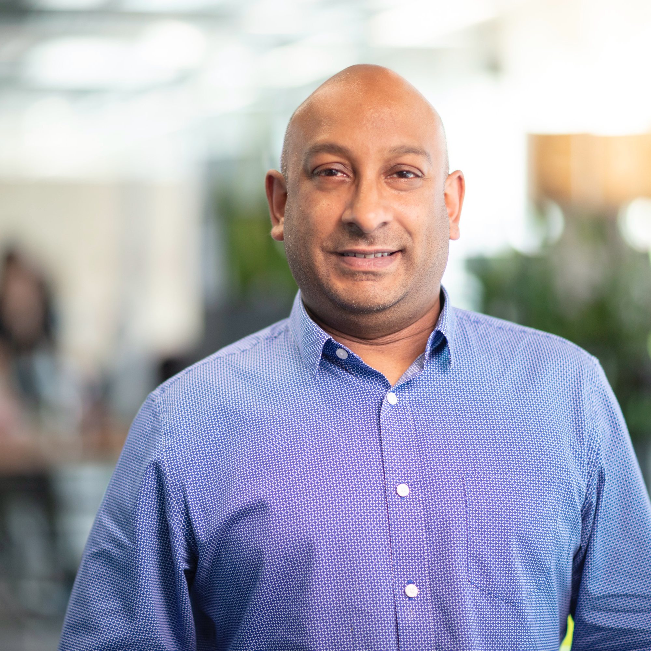
Extraordinary connections
PSTN Switch Off Andy Sobryan

Slide 2
Colt – who we are, what do we do
Quiz
Why are we doing this?
What does this affect?
New services

Slide 3
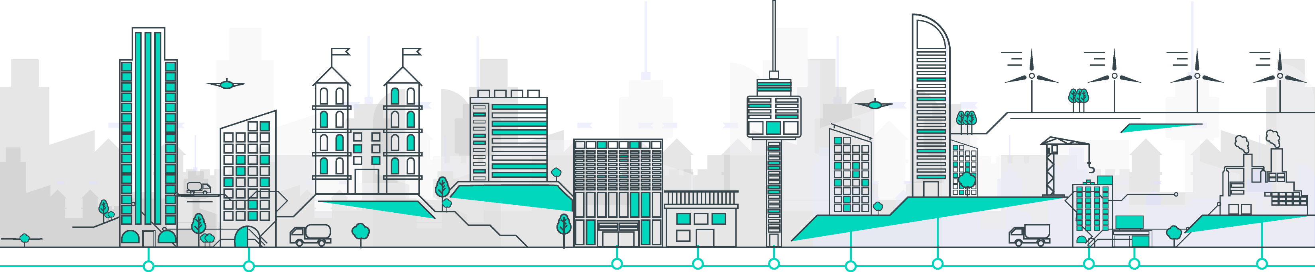
Digital infrastructure is the foundation of today’s connected business
System integrators
Resellers
Social networks
Financial market data feeds
Capital Markets exchange and venues
Global content
network providers
Cloud providers
Mobile operators
Consultants
Technology
providers
1,000+ data centres
31,000+ buildings with direct Fibre connections
51+ metropolitan area networks and over 220+ cities

Slide 4
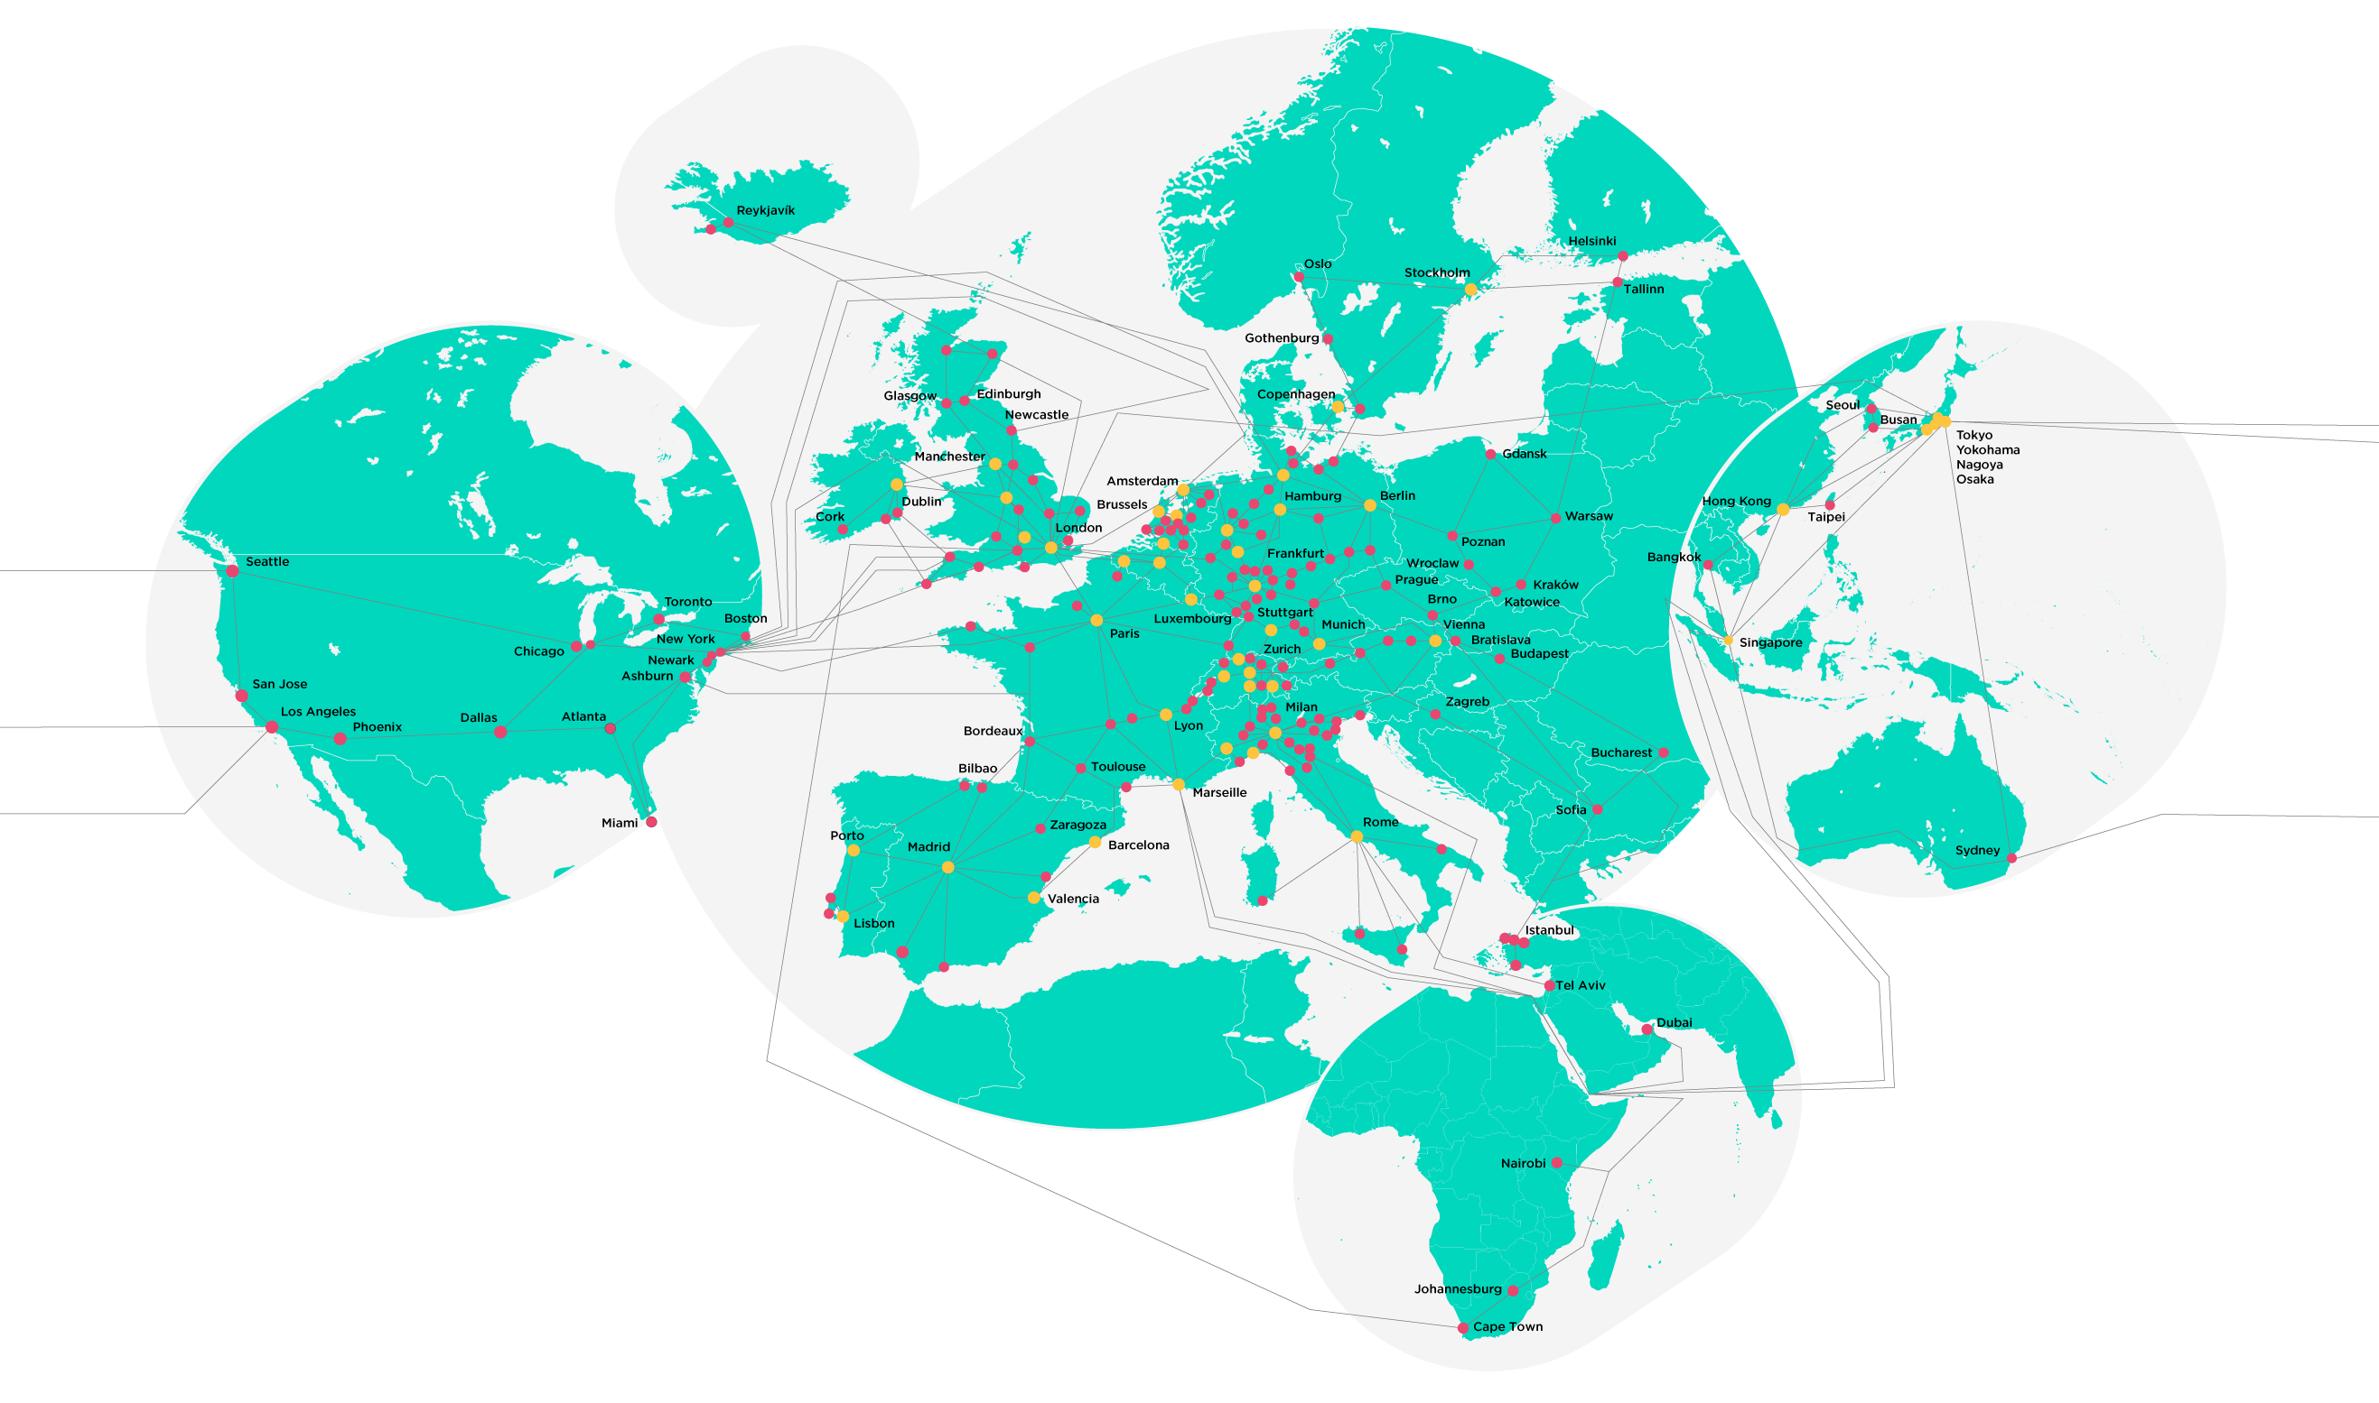
Network Scale
Number of connected countries | 40+
Number of MANS | 52
Number of connected cities* | 230+
Number of connected data centres | 1,100+
Number of connected buildings | 32,000+
 | Metropolitan area network
 | Colt connected city
 | Operational network managed end-to-end

Slide 5
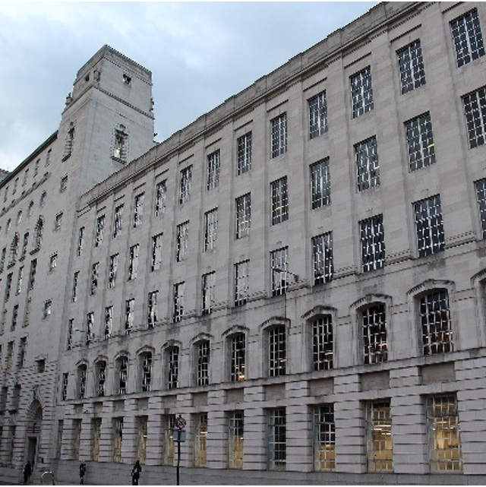
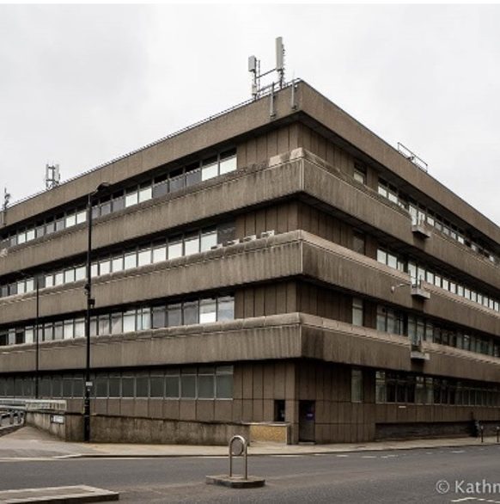
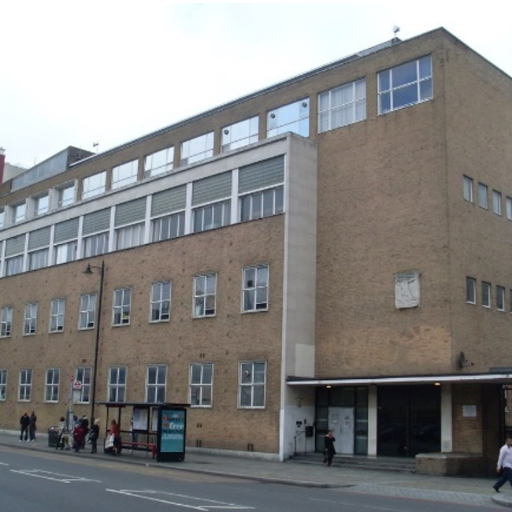
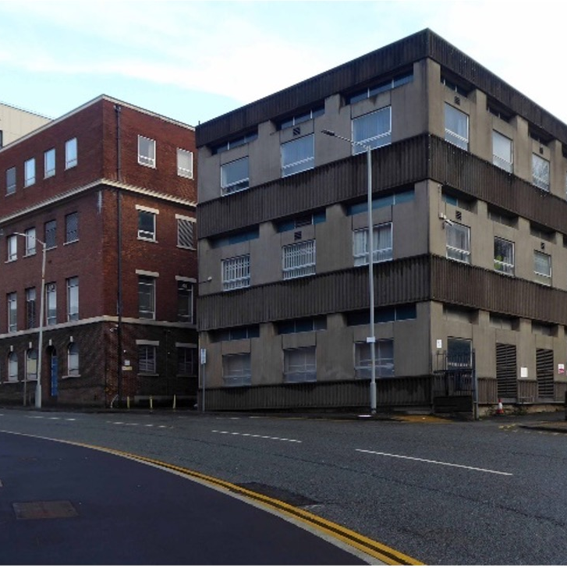
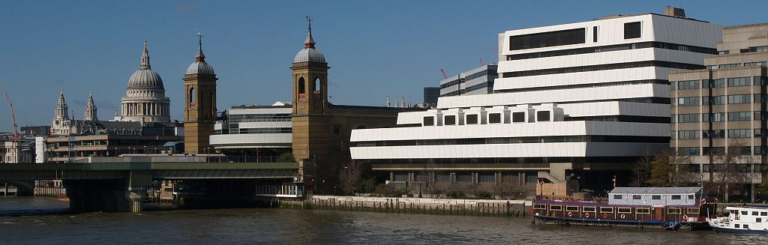
Baynard House
Shoreditch
Stockport
Faraday
Mondial

Slide 6
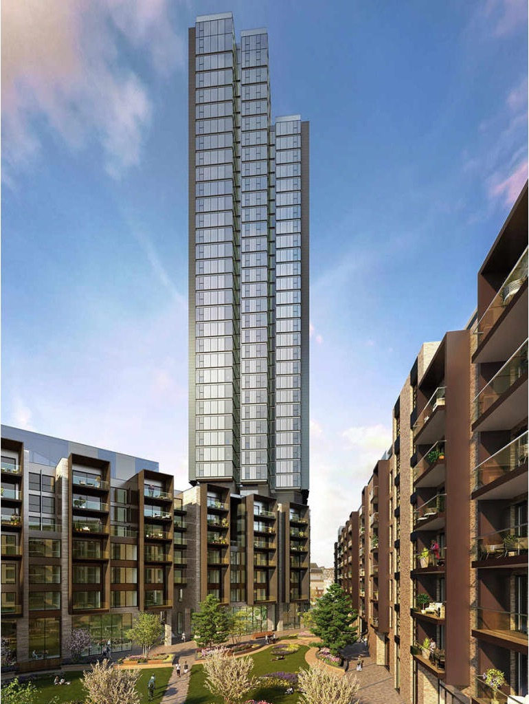
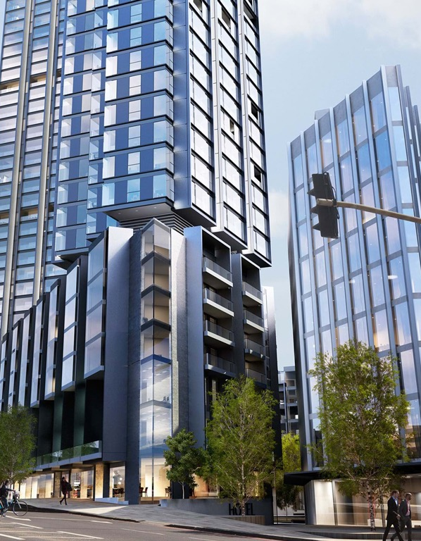
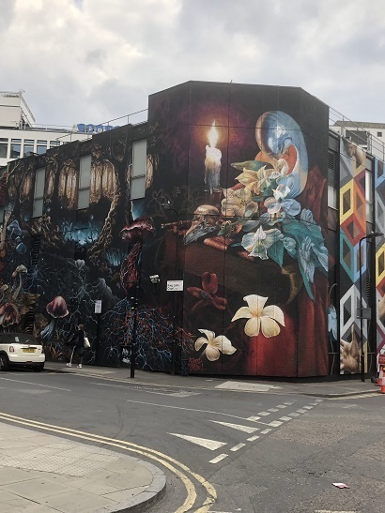

Slide 7
What were the programme drivers?
      Real estate rationalization
      Legacy equipment footprint of several decades.
      Network modernisation
      Cost saving – space, power, heat, maintenance contracts, OLO costs
      Enhanced sustainability.
      Declining revenue of traditional voice/data services. Reduced margin as other costs increase.
7

Slide 8

Network Scale
1
13 European countries
Helsinki
Stockholm
2
35 Cities with SDH Fibre
Glasgow
3
50 Nodes,510 central offices
Edinburgh
Copenhagen
Newcastle
4
426 Carrier hotels
Dublin
Manchester
Leeds
Hamburg
WGC
Amsterdam
Berlin
Warsaw
5
9 Technology suppliers
Birmingham
London
Hanover
Brussels
Dusseldorf
Dresden
6
20+ Technology models
Frankfurt
NUE
Prague
Krakow
Paris
Luxembourg
Stuttgart
Brno
7
11,000+ Core equipment
Munich
Vienna
Bratislava
Strasbourg
WEI
Salzburg
Budapest
Zurich
St. Jakob
8
60,000+ CPE’s
Geneva
BIS
Bordeaux
Lyon
Milan
Zagreb
9
20,000+ Customers
Bucharest
Bilbao
Turin
Belgrade
Toulouse
10
32 Telephone Exchanges
Zaragoza
Marseille
Sofia
Mudarra
Barcelona
Rome
11
1000000s meters of copper
Lisbon
Madrid
Valencia
12
1000000s of meters of fibre

Slide 9
Services migrated
Voice Services - ISDN PRI, ISDN BRI, Analogue PSTN lines
Data Services – legacy SDH based services
VoIP Interconnect – Operator to Operator connections

Slide 10
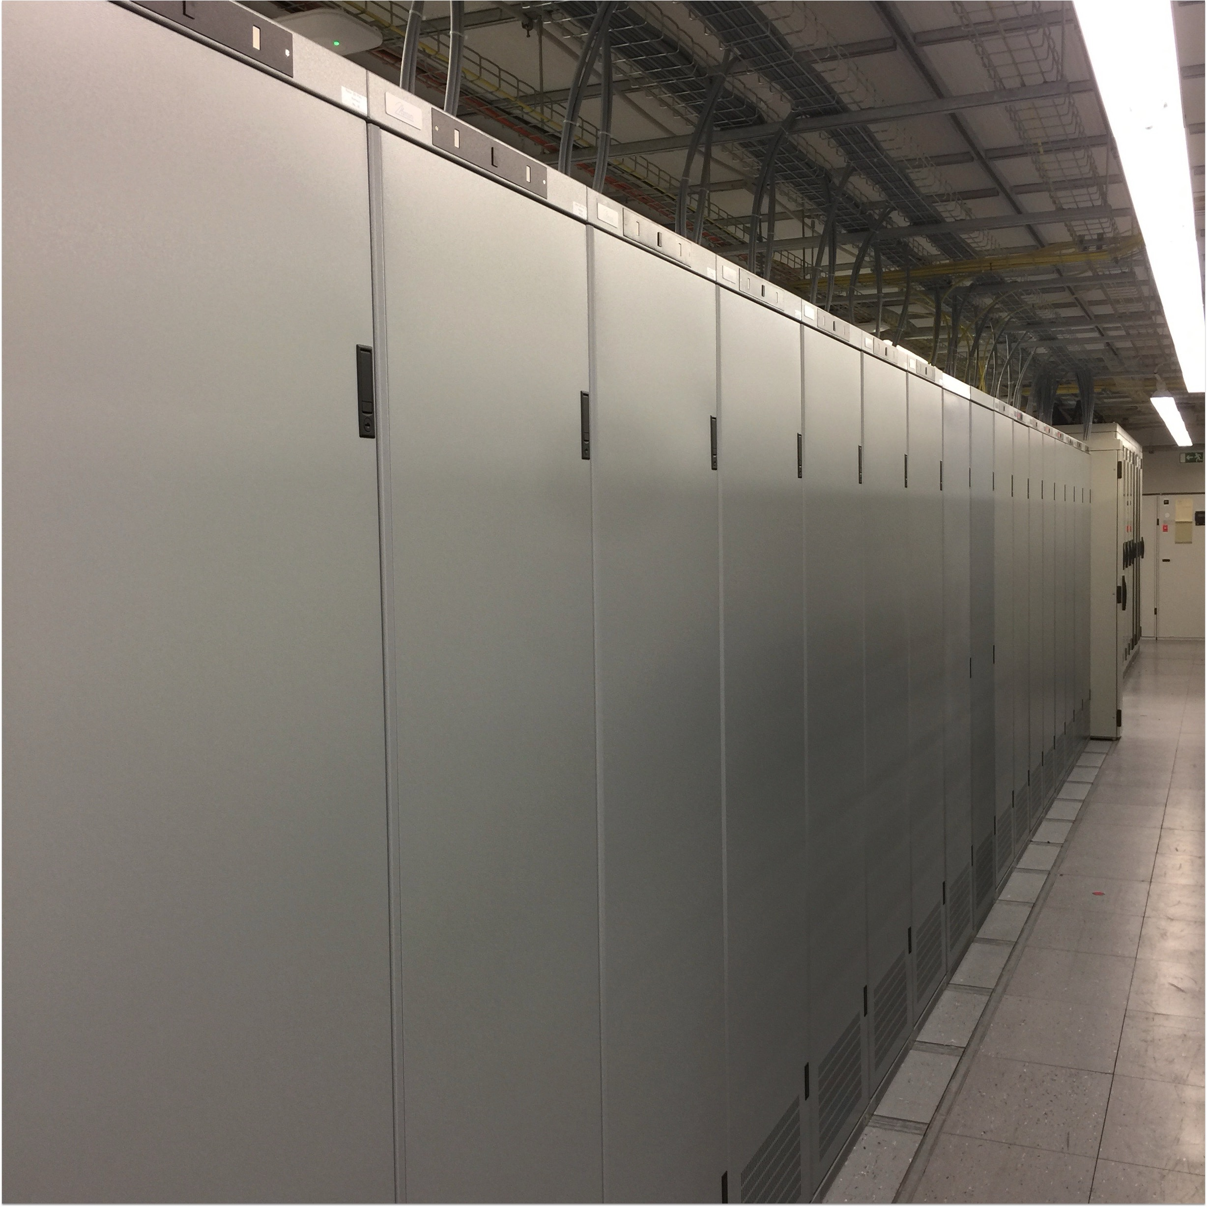
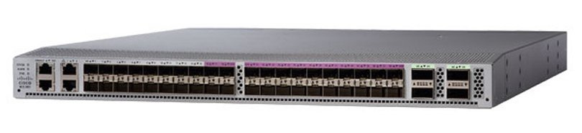
Footprint savings
In 1995, a Voice switch capable of switching 60,000 channels needed 20 (!) racks. In 2023 the same capacity is delivered by an equipment fitting in less than a quarter of one rack
The smallest network equipment delivers up to 1Terabit/s in a pizza-box format. Legacy SDH multiplexers delivered 2,5Gbps and filled half a rack (SMA16, 22U). To deliver 1Tbps, 400 SDH muxes would be required, taking up 200 racks (!)

Slide 11
Benefits realisation
Item
Drivers
Power
Power reduction across 50 nodes, Telephone Exchanges, SDH muxes, customer network, legacy OSS/BSS
Colocation
Savings from customer churn and retirement of legacy SDH/TDM equipment
Maintenance
Cost avoidance on node and network on electronics and spares.
SDH leased backbone
Savings from leased backbone and network costs for fibre/electronics.
Service Assurance
Ceasing service contracts for maintenance of SDH/TDM based services. Winding down of legacy skill set.
Colt highly confidential

Slide 12
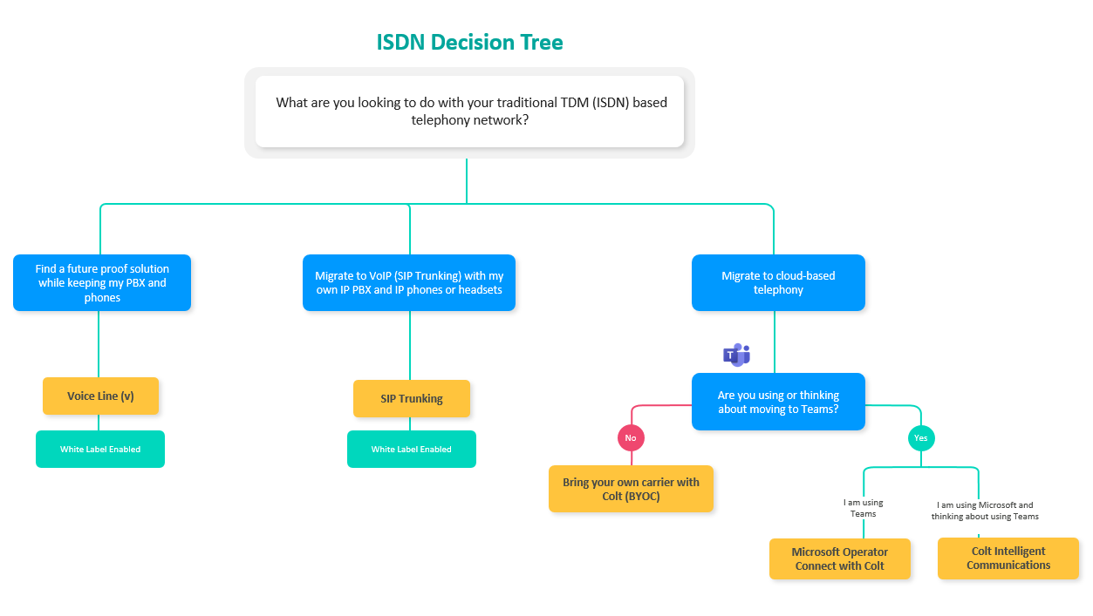
Replacement services
v
ISDN over SIP
Direct Routing

Slide 13






Replacement services
Colt continues to support ISDN
Customer
TDM PBX
VG
IP network
PRI
ISDN PRI/BRI
SIP Trunking
platform

Slide 14
Success
      130,000+ legacy circuits removed from our network.
      6,500 pieces of equipment, across more than 2,000 sites in Europe, have successfully been decommissioned.
      14.1 Gigawatt hours per year of annual reduction in energy consumption is expected as a result of these changes.
      2,800 business customers have also been migrated to more energy-efficient, sustainable digital infrastructure as part of our overall commitment to net zero. This gives our customers access to a diverse set of digital features and services – such as Voice over IP - which contributes to their own competitive ESG goals.

Slide 15

What did we need to do?
5 year programme plan
Data led with our ordering, inventory, legal finance systems needing to be pulled together using BI systems and home grown web tools
Massive data quality issues needed to be resolved.
Customer service team put together to communicate with customers. Multi-lingual. .
Legal letters in line with contract terms
How do we do it
Sales driven – accounts, agents, partners and wholesale
Silent migration
Forced migration. Forced cease.
Change on customer premise. New CPE required for Voice services.

Slide 16
Programme Goals
      Sales Opportunity
      Recognising the upsell which meant that we hit our growth and revenue targets
      Customer intimacy on legacy accounts.
      Customers already on their digital transformation journey.
      Customers just starting their journey.
      Where does it sit?
      Facilities, Finance, Telecoms, IT, externally.

Slide 17
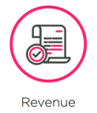
Programme Goals
      Revenue
      Retain profitable revenue and ceased services
      Reduce churn
      Awaken the slumbering customer.
      Mostly legacy customers.
      Increase customer intimacy
      Focus on high value customers
      Treat customer as a whole – all sites, all countries, all services.
      Low spending customers removed
      Circuits rationalised

Slide 18

PSTN lines are used for more than voice
Telemetry
(e.g. flood defence,
roadside, energy)
Marinas/
boat
moorings
Ships in docks
Alarm lines
Lift
lines
ATM
Emergency
lines
Faxes
CCTV
Telecare
Payment lines
and terminals
(e.g. ATMs, PDQs, EPOS)
Custodial tagging
Non-served
premises
(e.g. riverbank)
Business
continuity
Door entry systems
Line
powered
equipment
Estimated that round 20% of legacy lines are used for special services, and half of our customers will have a special service in use.​ Vulnerable use cases about 1%.

Slide 19
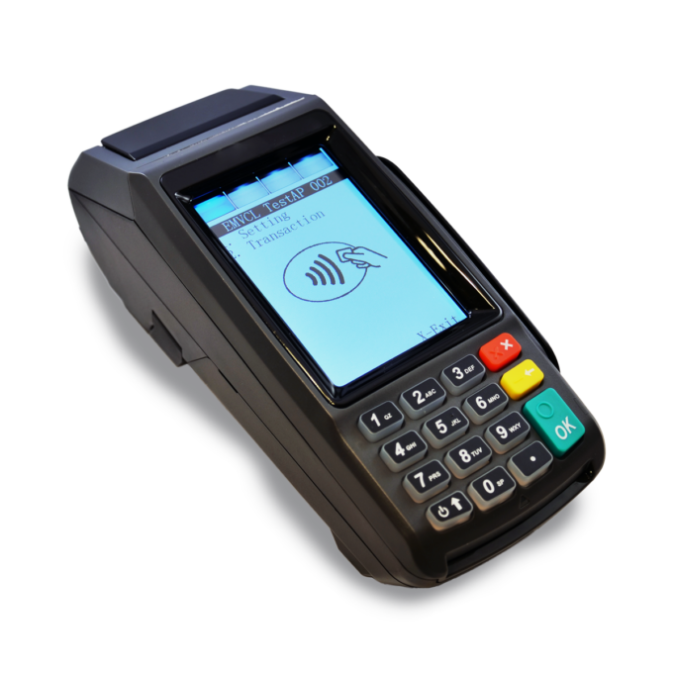
Challenges
      Critical services
      Use case – credit card payment terminals
      Relied on analogue lines from operators such as BT for the modem in the terminal.
      Which connected back to their payment system via ISDN using the data service.
      Customer unwilling to replace on their retailers payment terminals with internet enabled terminals. 100,000 terminals is a high cost for something which works fine today.
      Our replacement ISDN service is not made for data services.
      Due to high value of customer a solution was put in place with our Engineering team who also had to work with BT. Timers and config needed adjustment.

Slide 20

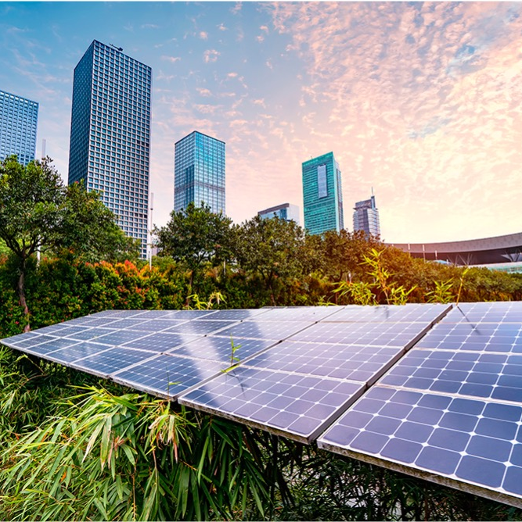



EcoVadis Platinum Medal
Top 1% of all companies.
CDP
Awarded A rating in 2024.
Shortlisted for employee engagement & behavior change Initiative of the Year

Slide 21
SDH- Sustainability
On our journey to become an ever more sustainable company by maximizing the positive impact we have on all our stakeholder groups while minimizing our negative impact throughout the value chain, SDH programme is contributing immensely, as we fulfil our vision.
14.1
GWh
per year
53 Nodes
9,500 kg CO2 per year*
70,000+
devices
Power consumption at Colt nodes in a year
Opportunities to remove equipment
By the end of the Programme, the power consumption will be reduced.
C02 released in the environment to generate the electricity consumed
All SDH TDM equipment removed from the 7 nodes.
Equipment recovery and recycling is self funding due to precious metals and value of copper.
Devices freed up after migration
On the back of the reduced need of power, the C02 release in the environment will be reduced.
These devices will go via the circular economy framework . Hence, will be reused, recycled or sold
* Scientific method being developed for centralized reporting

Slide 22
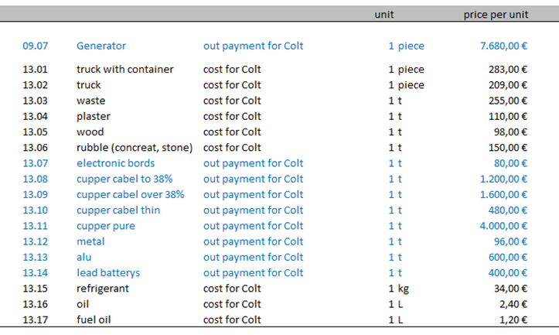
Dilapitdations
What it contains
Recovery partners
Working with our partner Urban Miners to sustainably recover all equipment in our nodes, colocation facilities, customer sites.
They paid us and provide reporting for our auditors.

Slide 23
History
      Other countries have already done this.
      Deutsche Telecom in Germany - ongoing
      Optus in Australia - completed
      Orange in France – ongoing by region
      Other countries not started.
      Legacy network withdrawal is a weekly occurrence in the industry.
      DSL connections for example are being removed across the world.
      BT Wholesale EFM
      Colocation, carrier hotels & datacentres closures worldwide
      Example: Rail infrastructure running network and voice services.

